Slide 1
DNS and DHCP Server Administration in Linux

Slide 2
01
04
Project Overview
Key Configurations
02
05
Technical Background
Project Outcomes
03
06
Implementation Strategy
Conclusion

Slide 3
01
PROJECT OVERVIEW

Slide 4
Objective
Scope
Configure DNS (Domain Name System) server using BIND
Set up DHCP (Dynamic Host Configuration Protocol) server
Integrate DNS and DHCP services for seamless network operations
CentOS Linux environment
Network-wide implementation
Focus on core DNS and DHCP functionalities

Slide 5
02
TECHNICAL BACKGROUND

Slide 6
FUNCTIONALITIES
DNS (Domain Name System)
DHCP (Dynamic Host Configuration Protocol)
Translates domain names to IP addresses
Hierarchical, distributed database system
Key Records: A, AAAA, CNAME, MX, NS
Automates IP address assignment to network devices
Manages IP address pool and network configurations
Four-step process: Discover, Offer, Request, Acknowledge

Slide 7
03
IMPLEMENTATION STRATEGY

Slide 8
Strategy
DNS Configuration
DHCP Configuration
Install BIND
Configure named.conf
Create zone files
Set up forward and reverse lookups
Install DHCP server
Define IP address pool
Configure DHCP options (gateway, DNS, lease time)
Integrate with DNS for dynamic updates

Slide 9
04
KEY CONFIGURATIONS

Slide 10

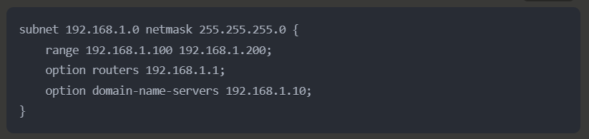
DNS Server (BIND)
DHCP Server

Slide 11
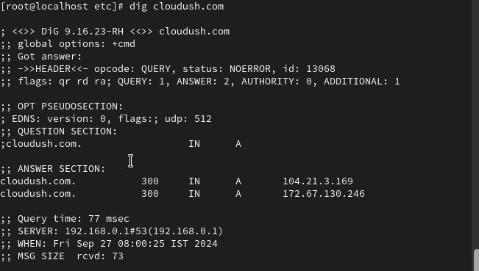
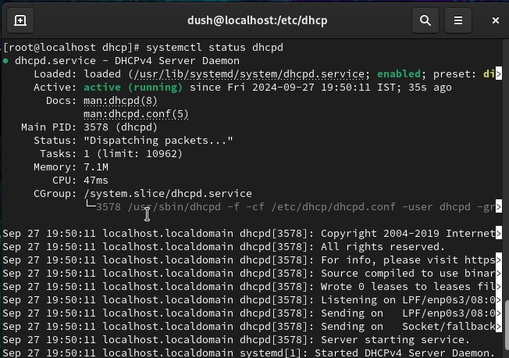
SCREENSHOTS
DNS Server (BIND)
DHCP Server

Slide 12
05
PROJECT OUTCOMES

Slide 13
OUR PROCESS
DHCP server automatically assigning IP addresses
Minimize network downtime due to IP conflicts
Functioning DNS server with forward and reverse zones
Consistent and error-free IP address management

Slide 14
06
CONCLUSION

Slide 15
Successfully implemented DNS and DHCP services on CentOS Linux
Achieved significant improvements in network management efficiency
Positioned the organization for future network growth and innovations

Slide 16
Any
Questions?

Slide 17
THANKS!
Done By: Guided By:
K. Dushyant Reddy Zakir Hussain Sir

